Slide 1

Machine Learning Algorithms Computer vision – OpenCV
Raghu Prasad Konandur
9845547471
www.kaushalya.tech
raghuprasadkonandur@kaushalya.tech

Slide 2
Introduction
Raghu Prasad – BE, MS
Total of 27 years of experience
7 years as a lecturer in an Engineering College
20 Years into IT
Worked with companies like CISCO,CSC,ICICI,First Apex – NTT Data
Currently into Corporate training and consultancy
Worked with corporates and public sector
Service Offerings – In person/On-line/Corporate/Academic Institutes
Consultancy – Consultant to vendor of Atal Tinkering Lab/ECIL-ECIT, Incarnus – Healthcare Service Provider
Technologies – Java,Python,Web technologies,Java Script technologies (MEAN stack),IOT,Test Automation,Machine Learning,Artificial Intelligence,ERP,.NET
Customers – Philips,L & T,NextGen,Incarnus,Aspire system,BGS-IT,Sindhi College,Malnad Enginering College,S B College of Management, REVA University,Nagarjuna Engineering College,Dayanand Sagar University,Acharya Institute of Technology,NIE Mysore,NIT-Imphal,etc

Slide 3
Topics
Computer vision with openCV
Image Acquisition
Image Processing
Image Analysis

Slide 4
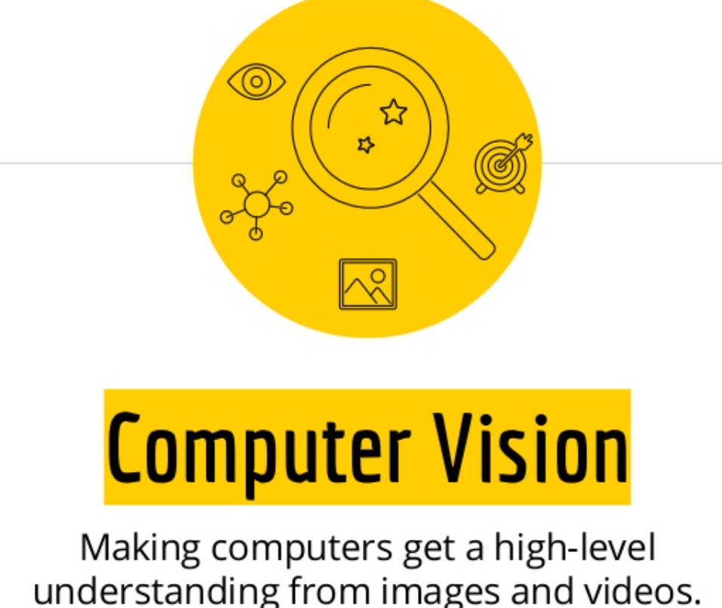
Computer Vision

Slide 5
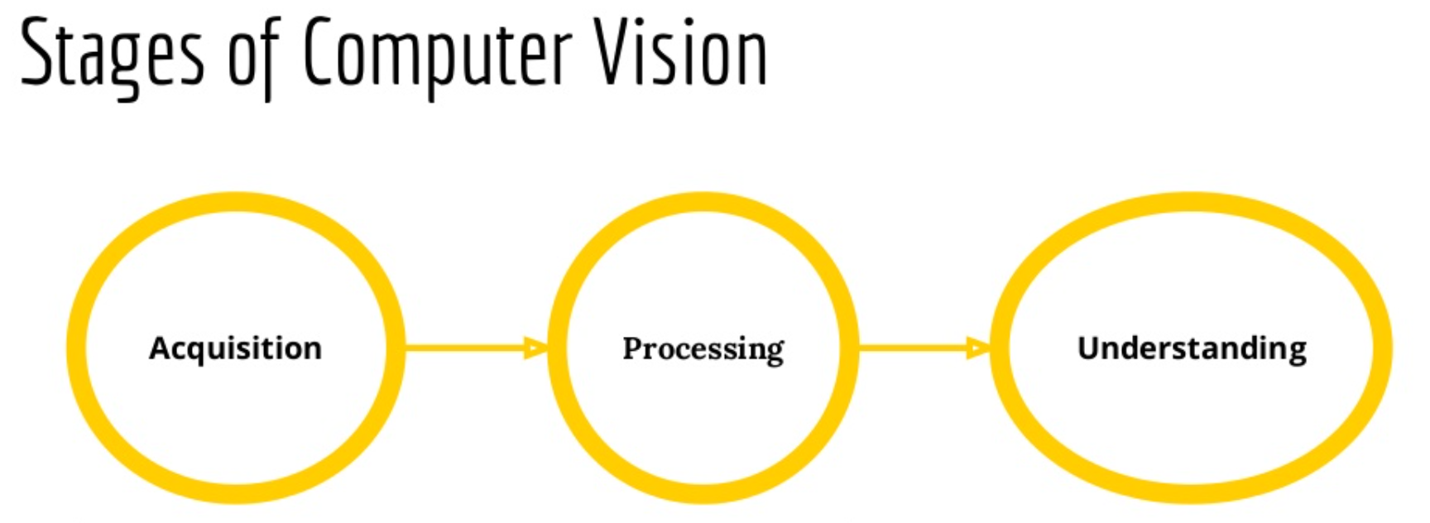
Computer Vision

Slide 6

Open CV

Slide 7
Open CV
OpenCV is a huge open-source library for computer vision, machine learning, and image processing. OpenCV supports a wide variety of programming languages like Python, C++, Java, etc. It can process images and videos to identify objects, faces, or even the handwriting of a human. When it is integrated with various libraries, such as Numpy which is a highly optimized library for numerical operations, then the number of weapons increases in your Arsenal i.e whatever operations one can do in Numpy can be combined with OpenCV.

Slide 8
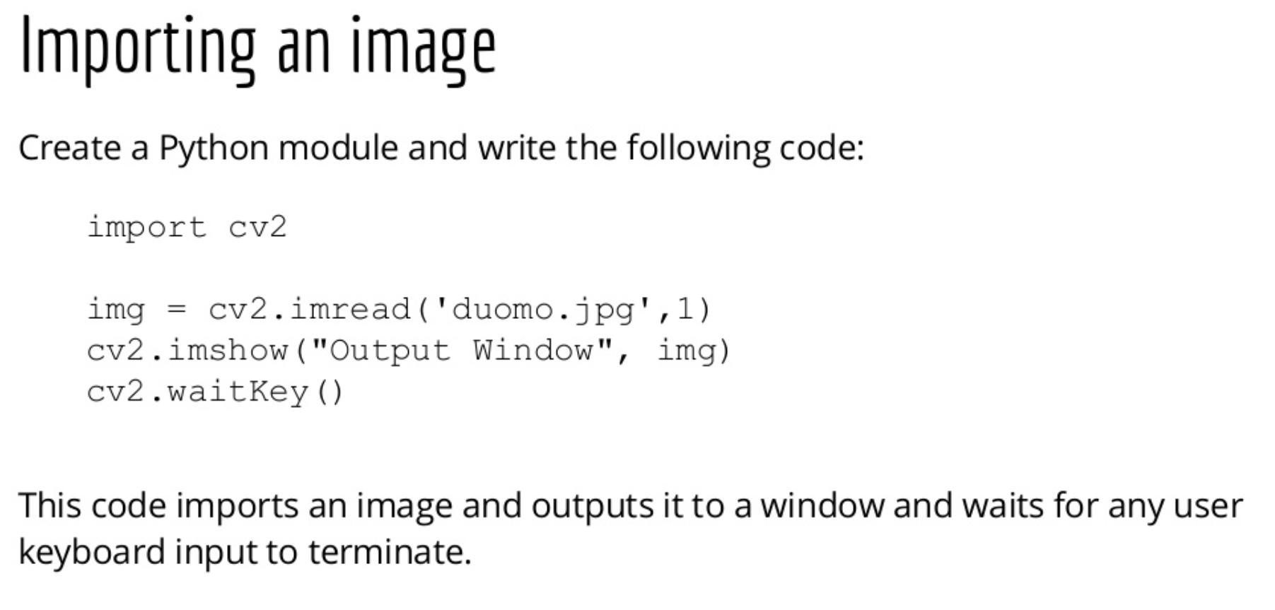
Acquiring Image Data

Slide 9
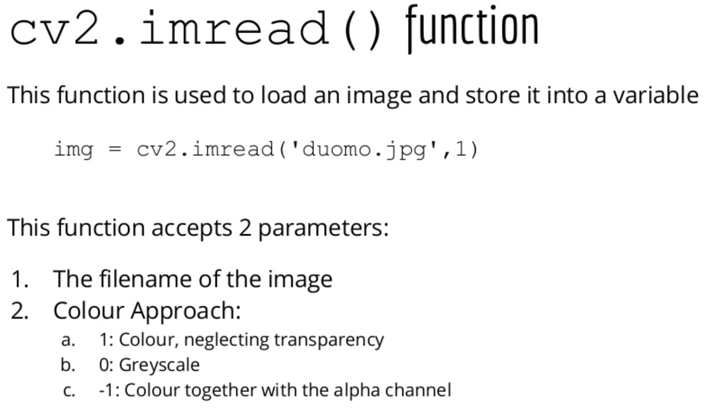
Acquiring Image Data

Slide 10
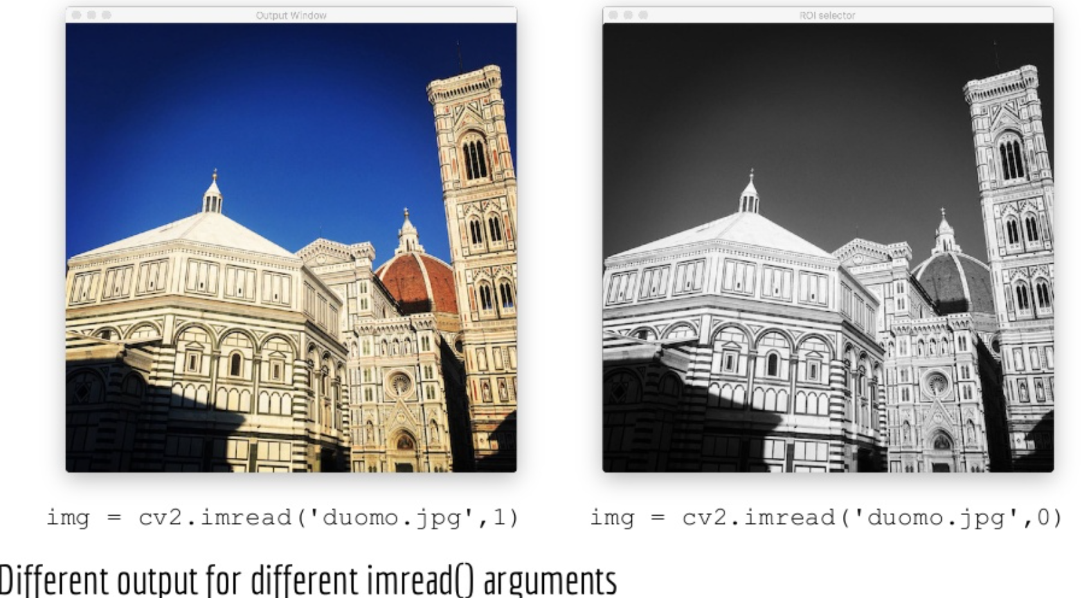
Acquiring Image Data

Slide 11
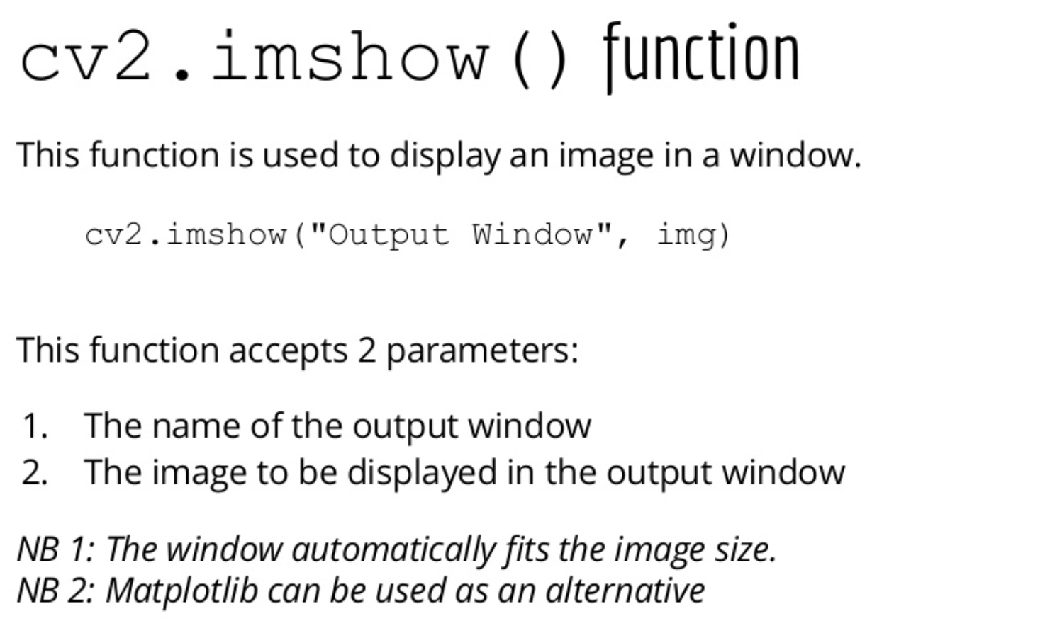
Acquiring Image Data

Slide 12
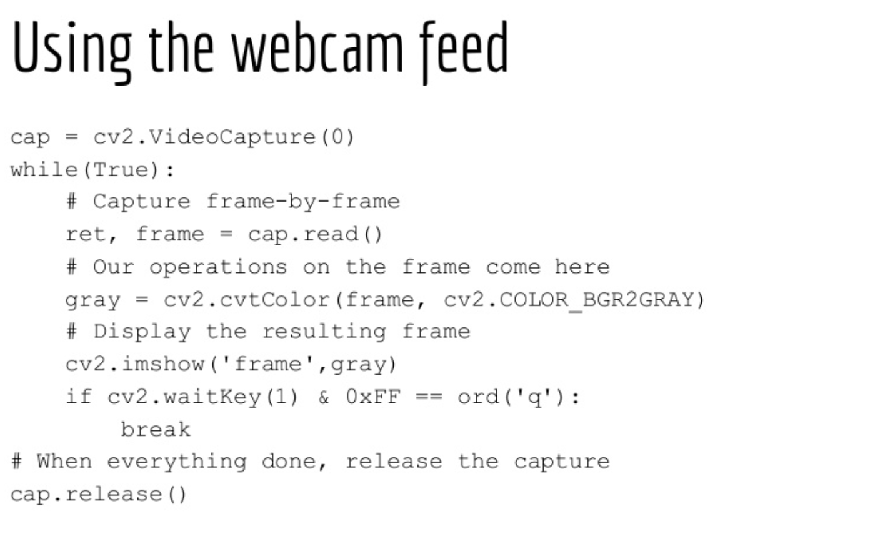
Webcam Feed

Slide 13
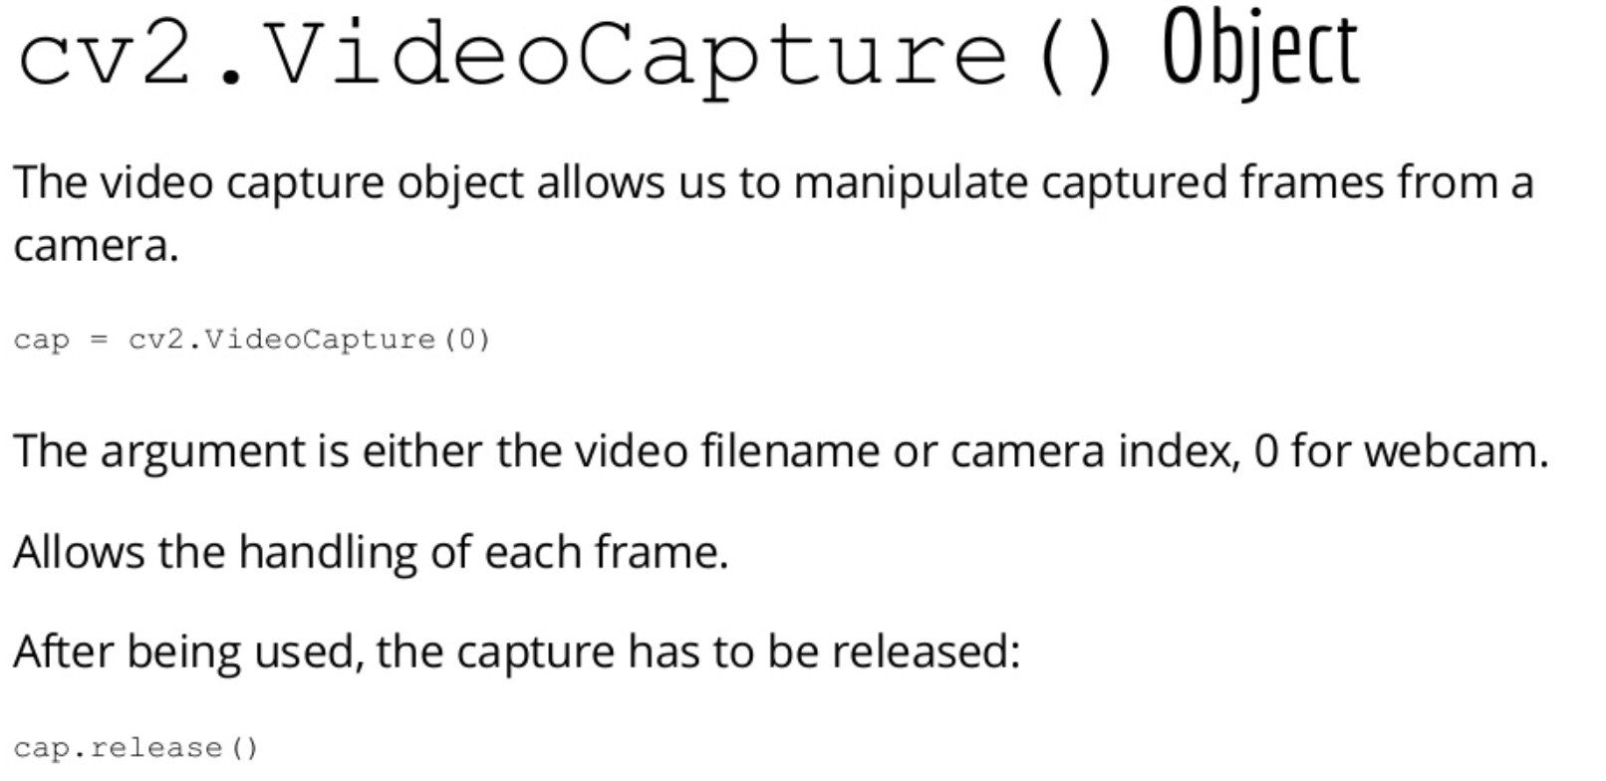
Webcam Feed

Slide 14
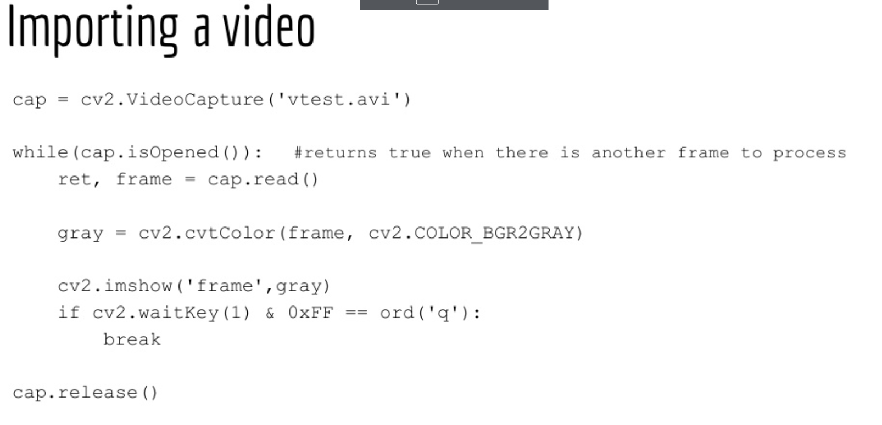
Importing a video

Slide 15
Hands-on
Image processing
Capturing image from Webcam
Face detection

Slide 16
References
https://www.skillbasics.com/
https://www.kaggle.com/

Slide 17
Thank You
Raghu Prasad Konandur
9845547471
www.kaushalya.tech
raghuprasadkonandur@kaushalya.tech

